Slide 1

Cloud Design Pattern for Azure: Design and Implementation
Umamaheswaran (UMW360)
BizTalk360

Slide 2
Recap
What is Cloud Design pattern
External configuration pattern
Federated Identity Pattern

Slide 3
Agenda
Gatekeeper Pattern
Run time configuration pattern
Valet key pattern

Slide 4
Gatekeeper pattern

Slide 5
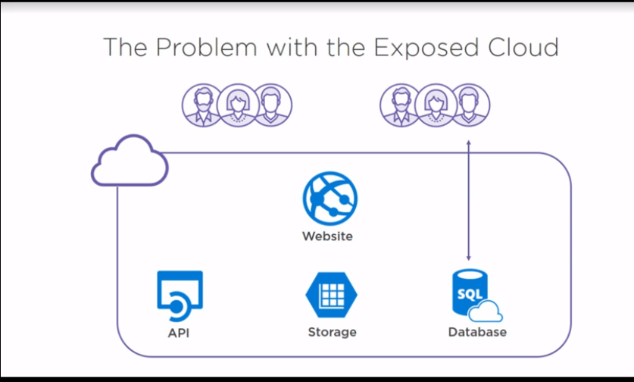

Slide 6
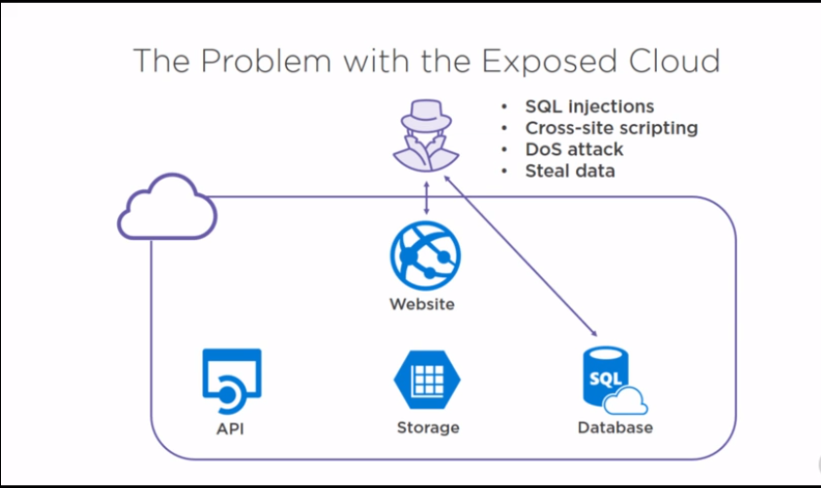

Slide 7
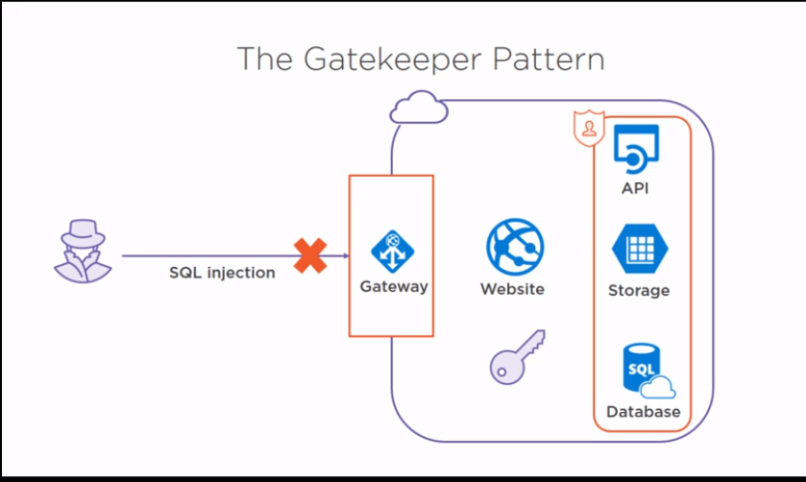

Slide 8
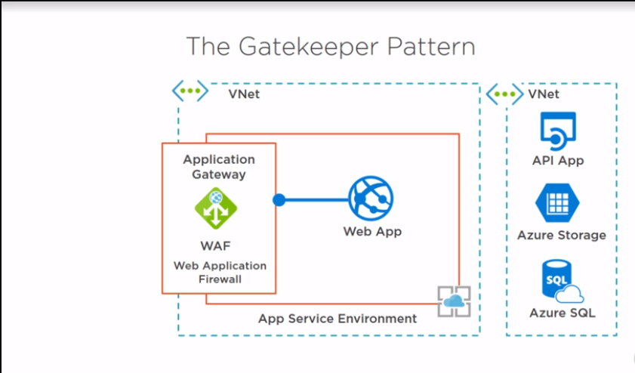

Slide 9
Runtime reconfiguration pattern

Slide 10
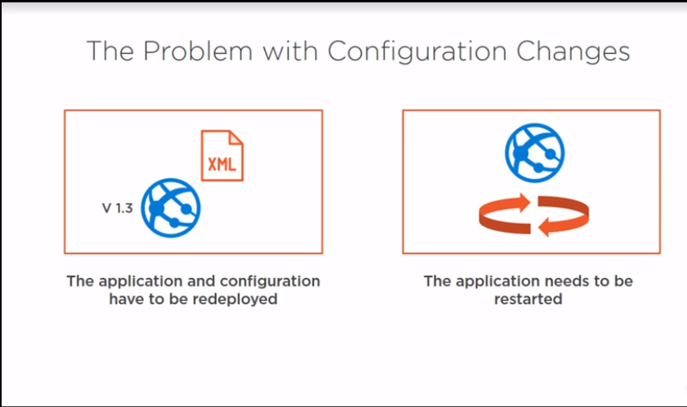

Slide 11
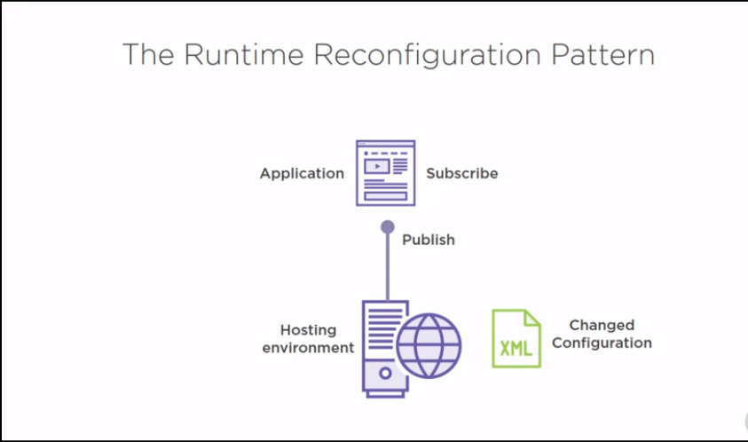

Slide 12
Valet key pattern

Slide 13
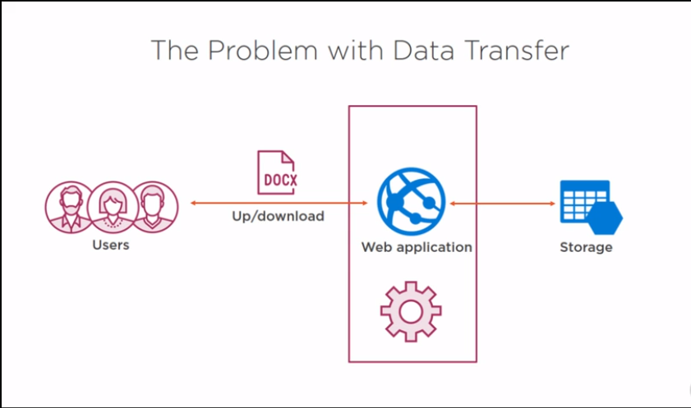

Slide 14
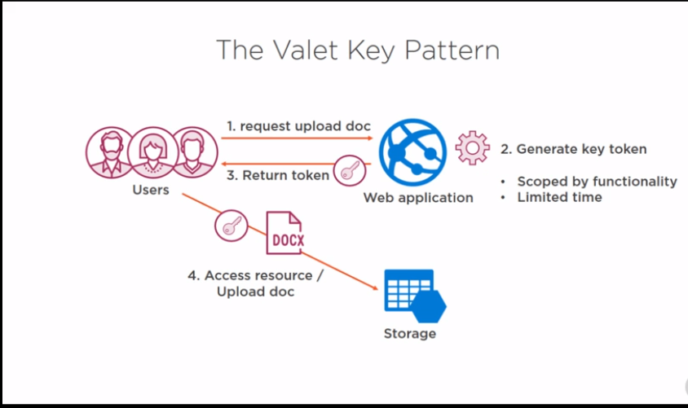

Slide 15
Thank you

